Slide 1
Dynamic Data Wrangling with Azure Data Bricks

Slide 2





HLD For DQ Engine
Metadata tables
columnInfo
ruleInfo
mappingInfo
fileInfo
Azure Storages
Ingestion
Dumping
Azure Storages
Azure Databricks
Dynamic data transform using Pyspark

Slide 3
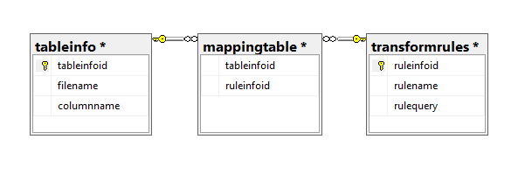



Metadata Files
1
M
M
Automatic population
Multiple rules can be applied to one particular column, conversely one rule can also be applied to multiple columns.

Slide 4
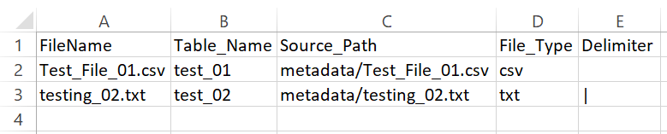
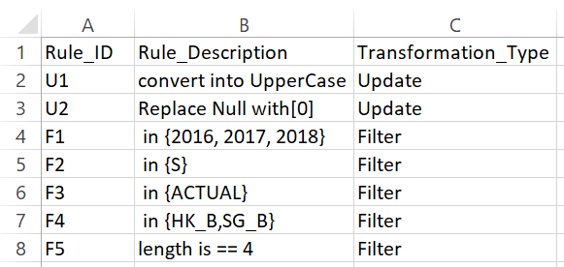
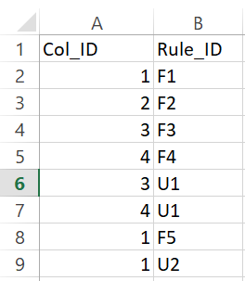
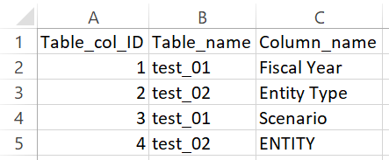
mappingInfo.csv
Metadata Files
fileinfo.csv
ruleInfo.csv
tableInfo.csv

Slide 5








Architecture Design
Data Layer
Raw Layer
Curated Layer
Data Source 1
Data Sink 1
Data Source 2
Data Sink 2
Processing Layer
Data Source 3
Rule fetching
Meta query parsing
Data transformation
Data Sink 3
Raw data from data source
Transformed data frame
Categorizing the rules as required and performing transformations accordingly.

